Slide 1
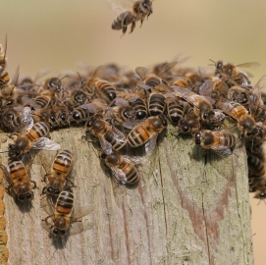
Waggle run distributions quantify collective foraging in honey bee colonies
Joseph Palmer, Ash Samuelson, Elli Leadbeater & Vincent Jansen

Slide 2
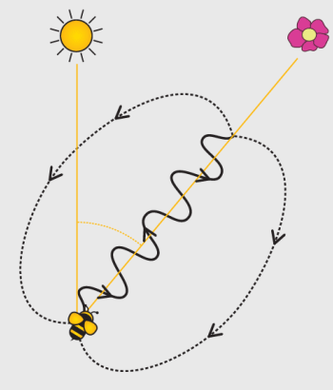
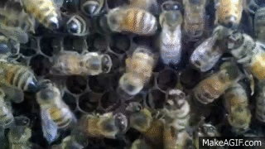
Honeybee waggle dance

Slide 3
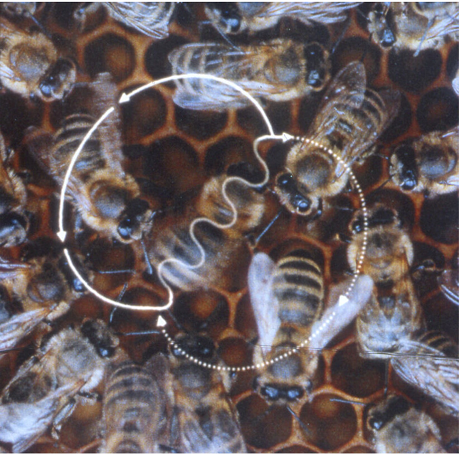
Is using the dance always best?

Slide 4
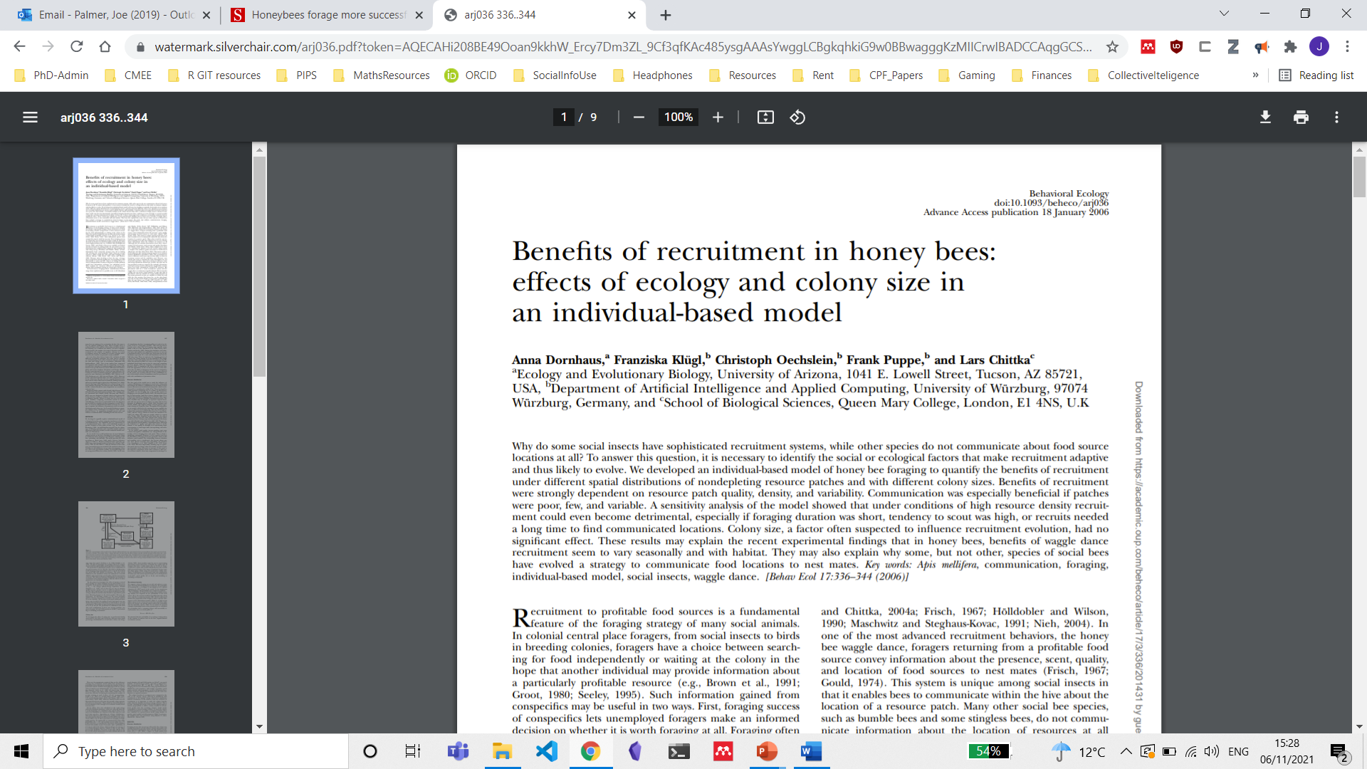
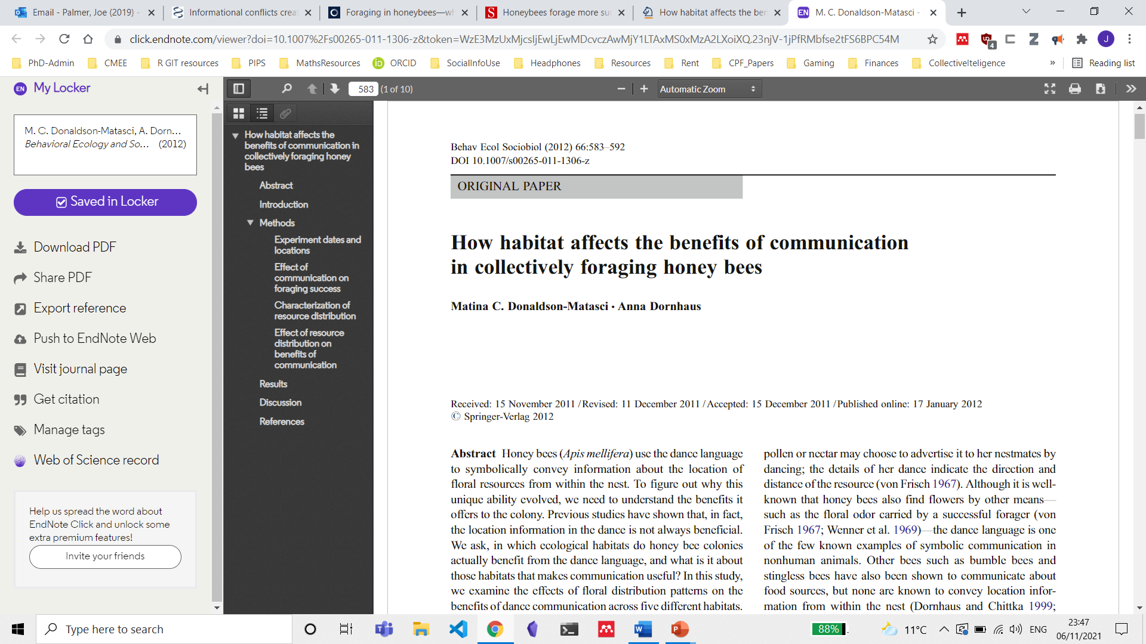
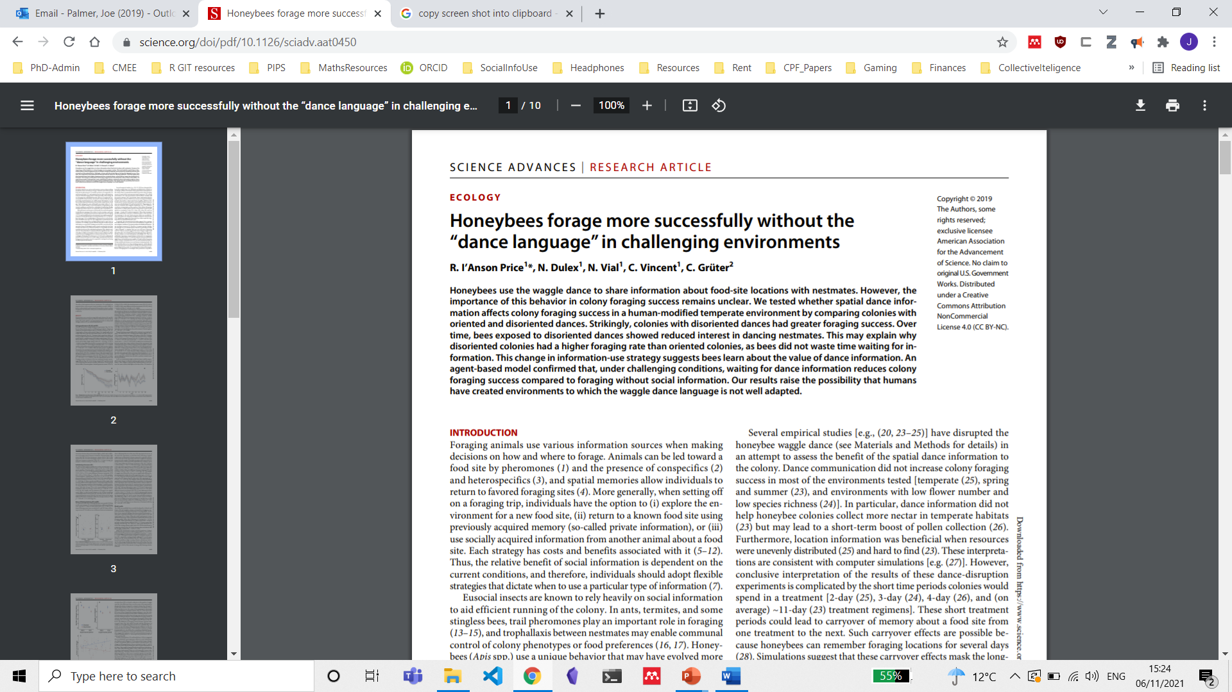
Colony level studies show many factors influence benefits of dancing

Slide 5
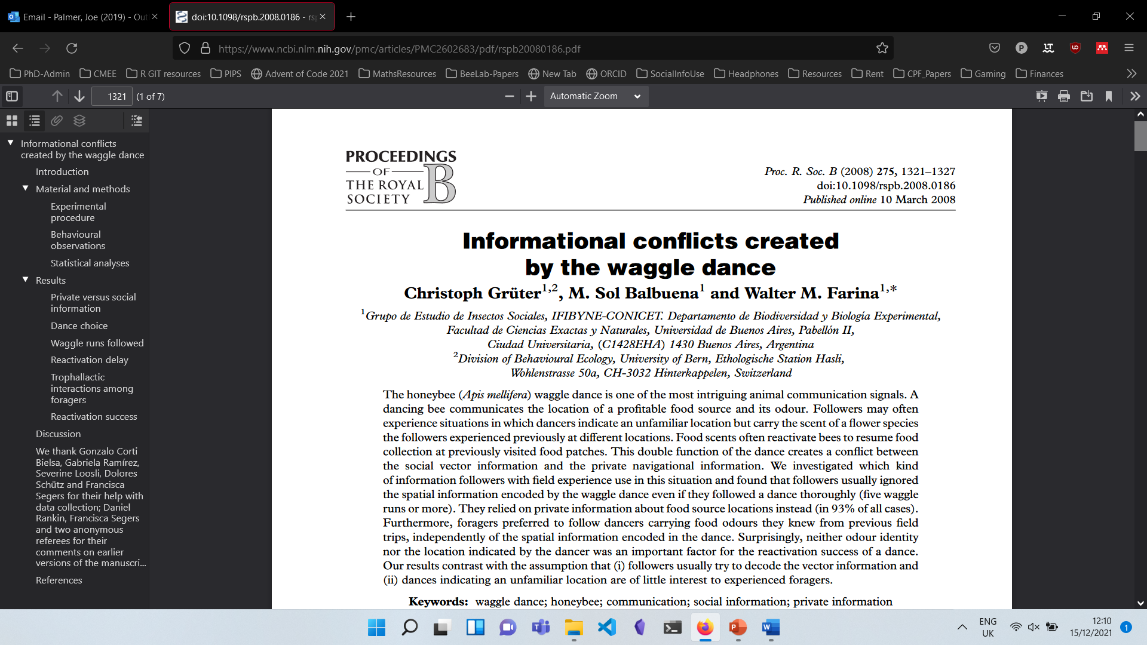
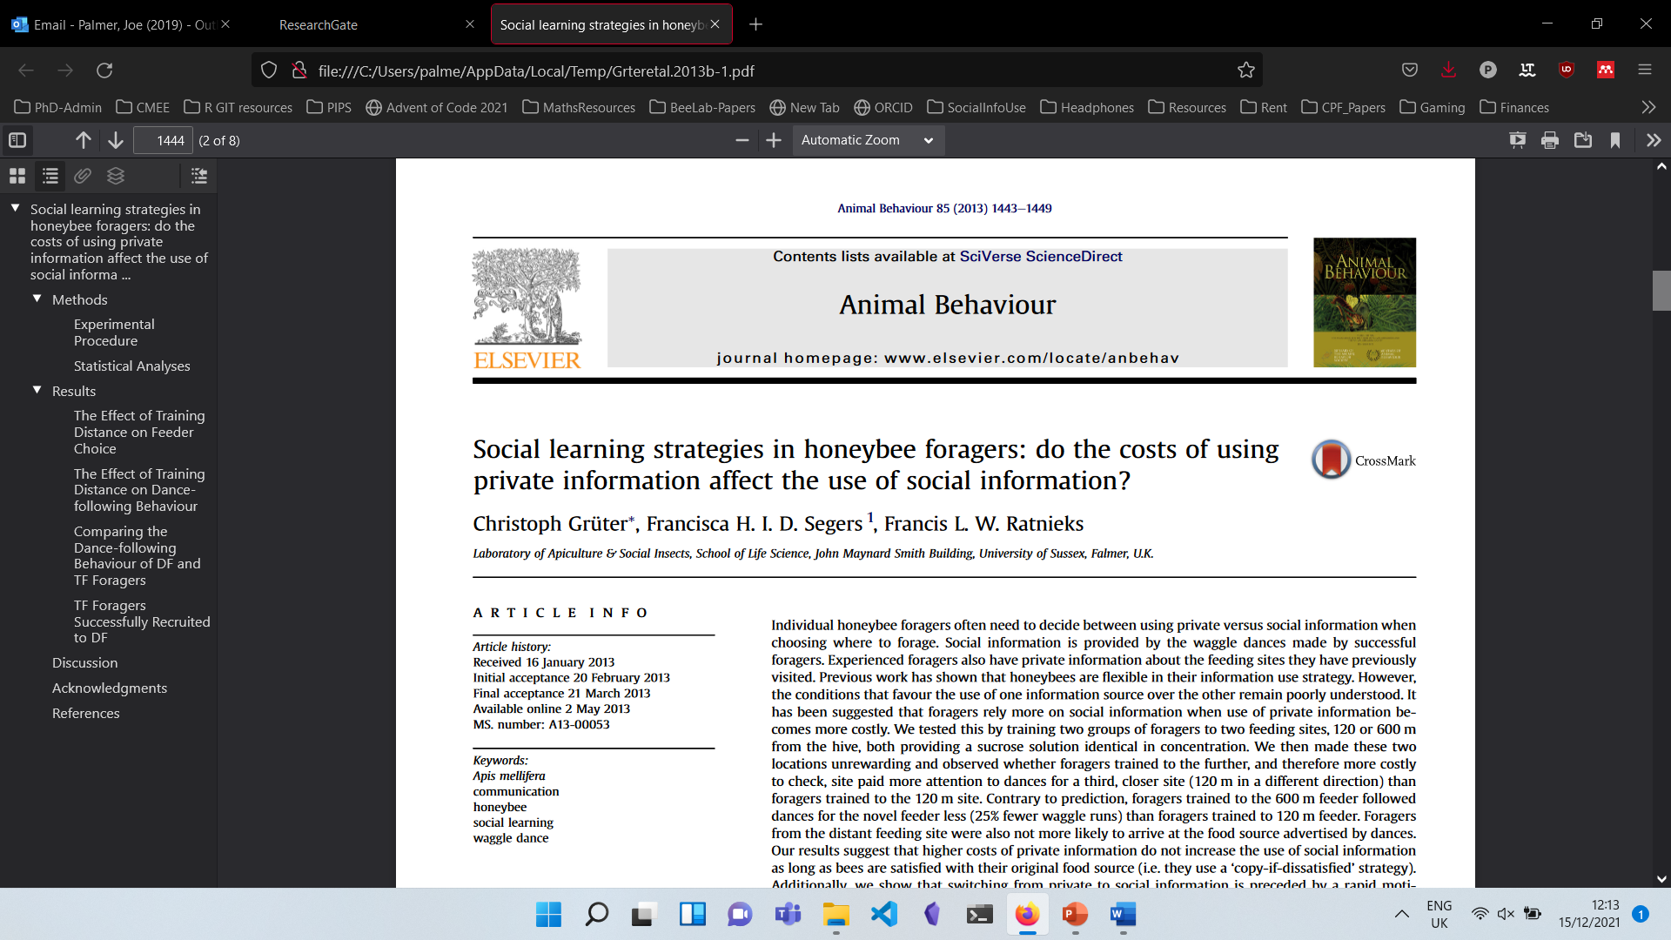
Colony level studies show environment influences benefits of dancing
Individual level studies show how foragers use the waggle dance

Slide 6
How can we quantify waggle dance use at the colony level?

Slide 7
How can we quantify waggle dance use at the colony level?
Rotate hive to remove spatial component of the dance
Requires disturbing colonies
Constant monitoring of real-world colony weight
Scaling to a level that allows inter-colony variation in foraging environments to be assessed is a major logistical hurdle
Hive disorientation

Slide 8
Can we find another way?

Slide 9
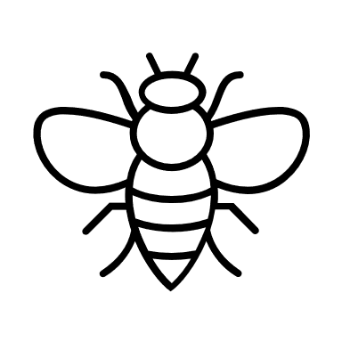

A model of foraging patterns
Scouts
Recruits
Vs.
Do different foraging strategies leave different waggle dance patterns?

Slide 10
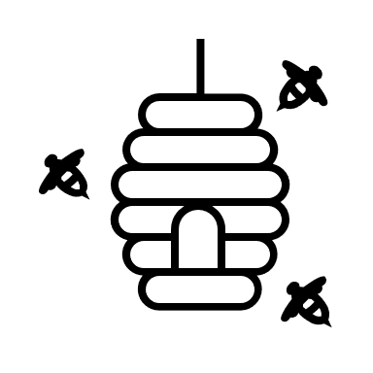
Simulation of honeybee foraging

Slide 11
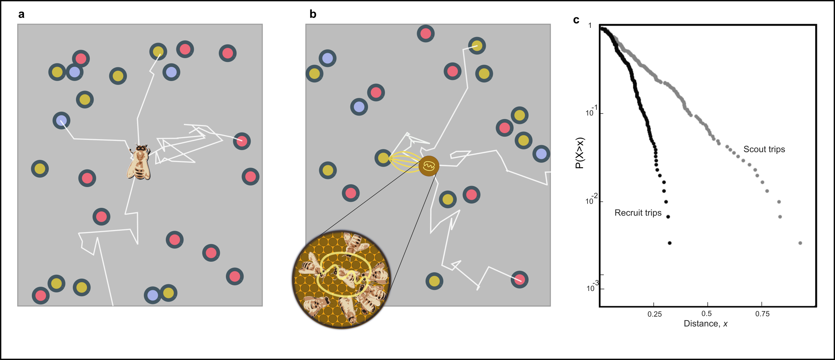
Scout foraging
Scouts leave the hive on a random flight path (white lines) until they encounter a resource (coloured point).
Different flowers have different qualities, e.g. nectar concentration / abundance (colour)

Slide 12
Recruits foraging
Recruits sample a dance randomly from the dance floor
Recruits forage and dance if they judge it profitable
Creates a self enhancing process for the ‘best’ resources.

Slide 13
Simulated foraging patterns
Distribution of distances reported by scouts is exponential
Distribution of distances reported by recruits is the minimum of an exponential
Different foraging strategies leave different patterns on the dance-floor.

Slide 14
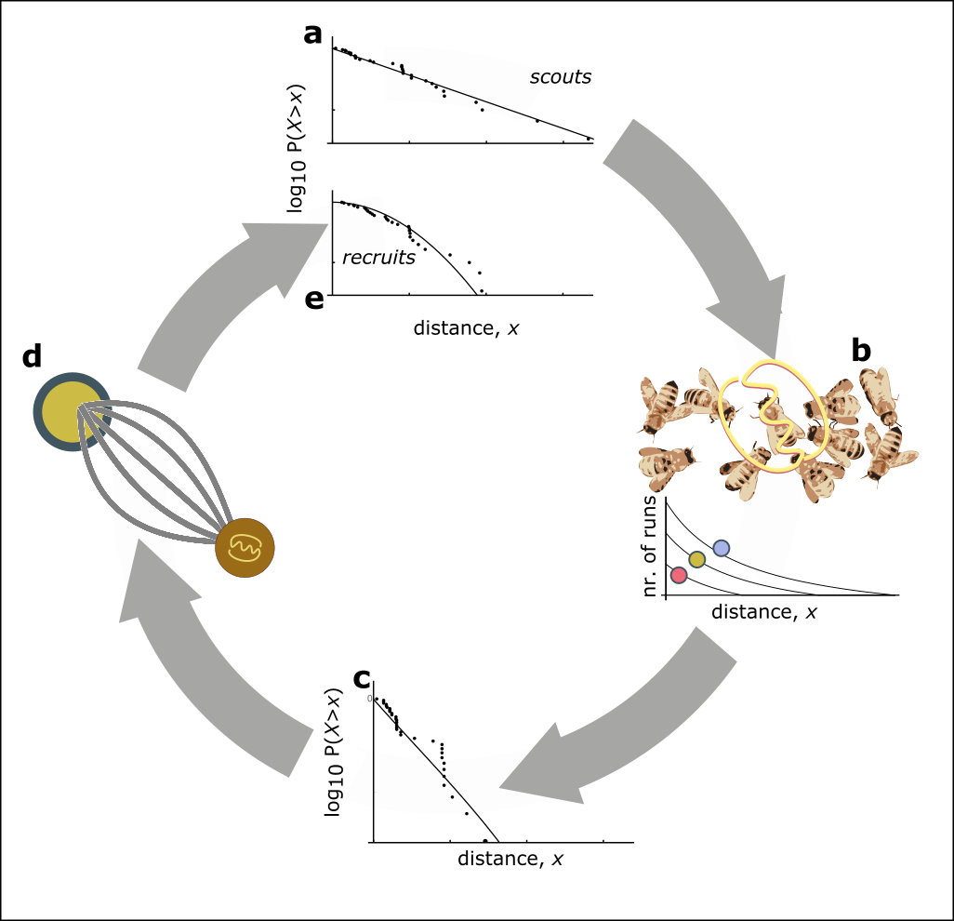
Collective foraging
Scouts return exponentially distributed foraging distances
Nr. waggle runs varies by quality
Dancing biased towards closer, ‘better’ resources
Randomly sampling recruits drive recruitment to the best resources
Resulting in a different pattern of dances to scouts
p
+
(1-p)
Individual foraging

Slide 15
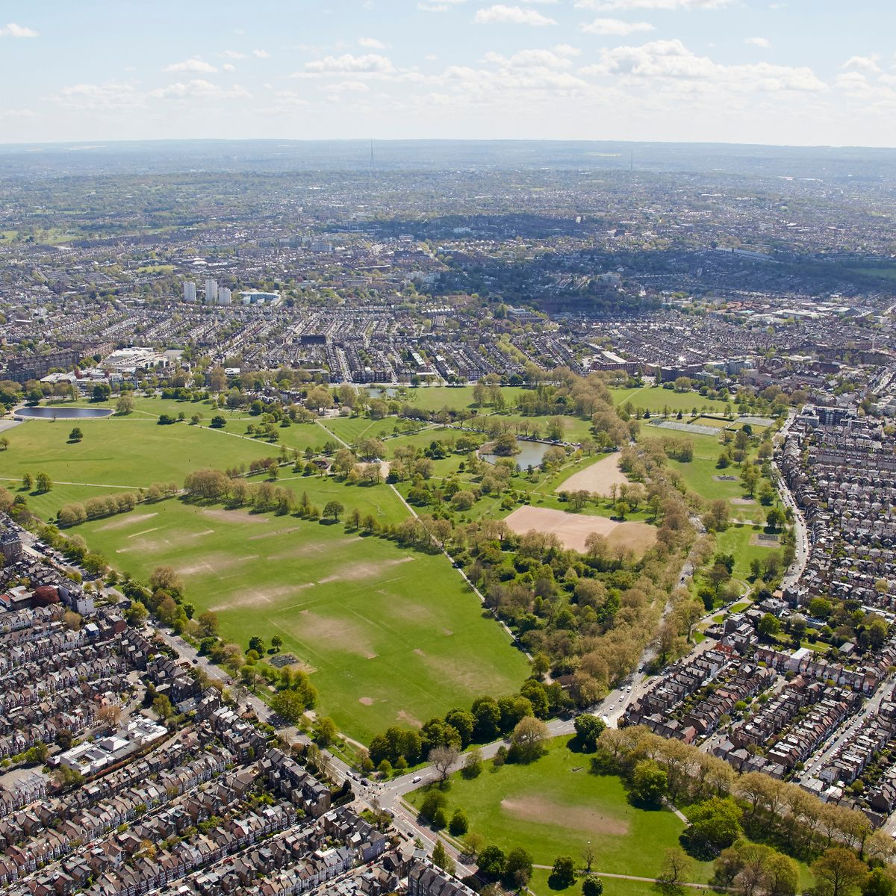
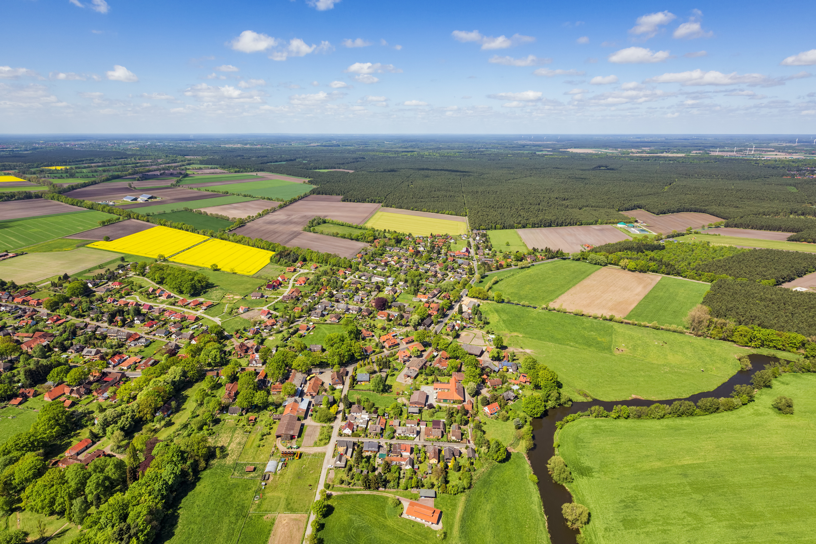
How well does our model describe ‘real’ honeybee foraging?
Fit our model to waggle dance data from 20 hives, collected across two years in an urban and agri-rural environment (10 sites each).
Use established model fitting techniques:
Maximum likelihood for fitting.
Akaike information criterion (AIC) for parsimony.
Kolmogorov–Smirnov test for goodness of fit.

Slide 16
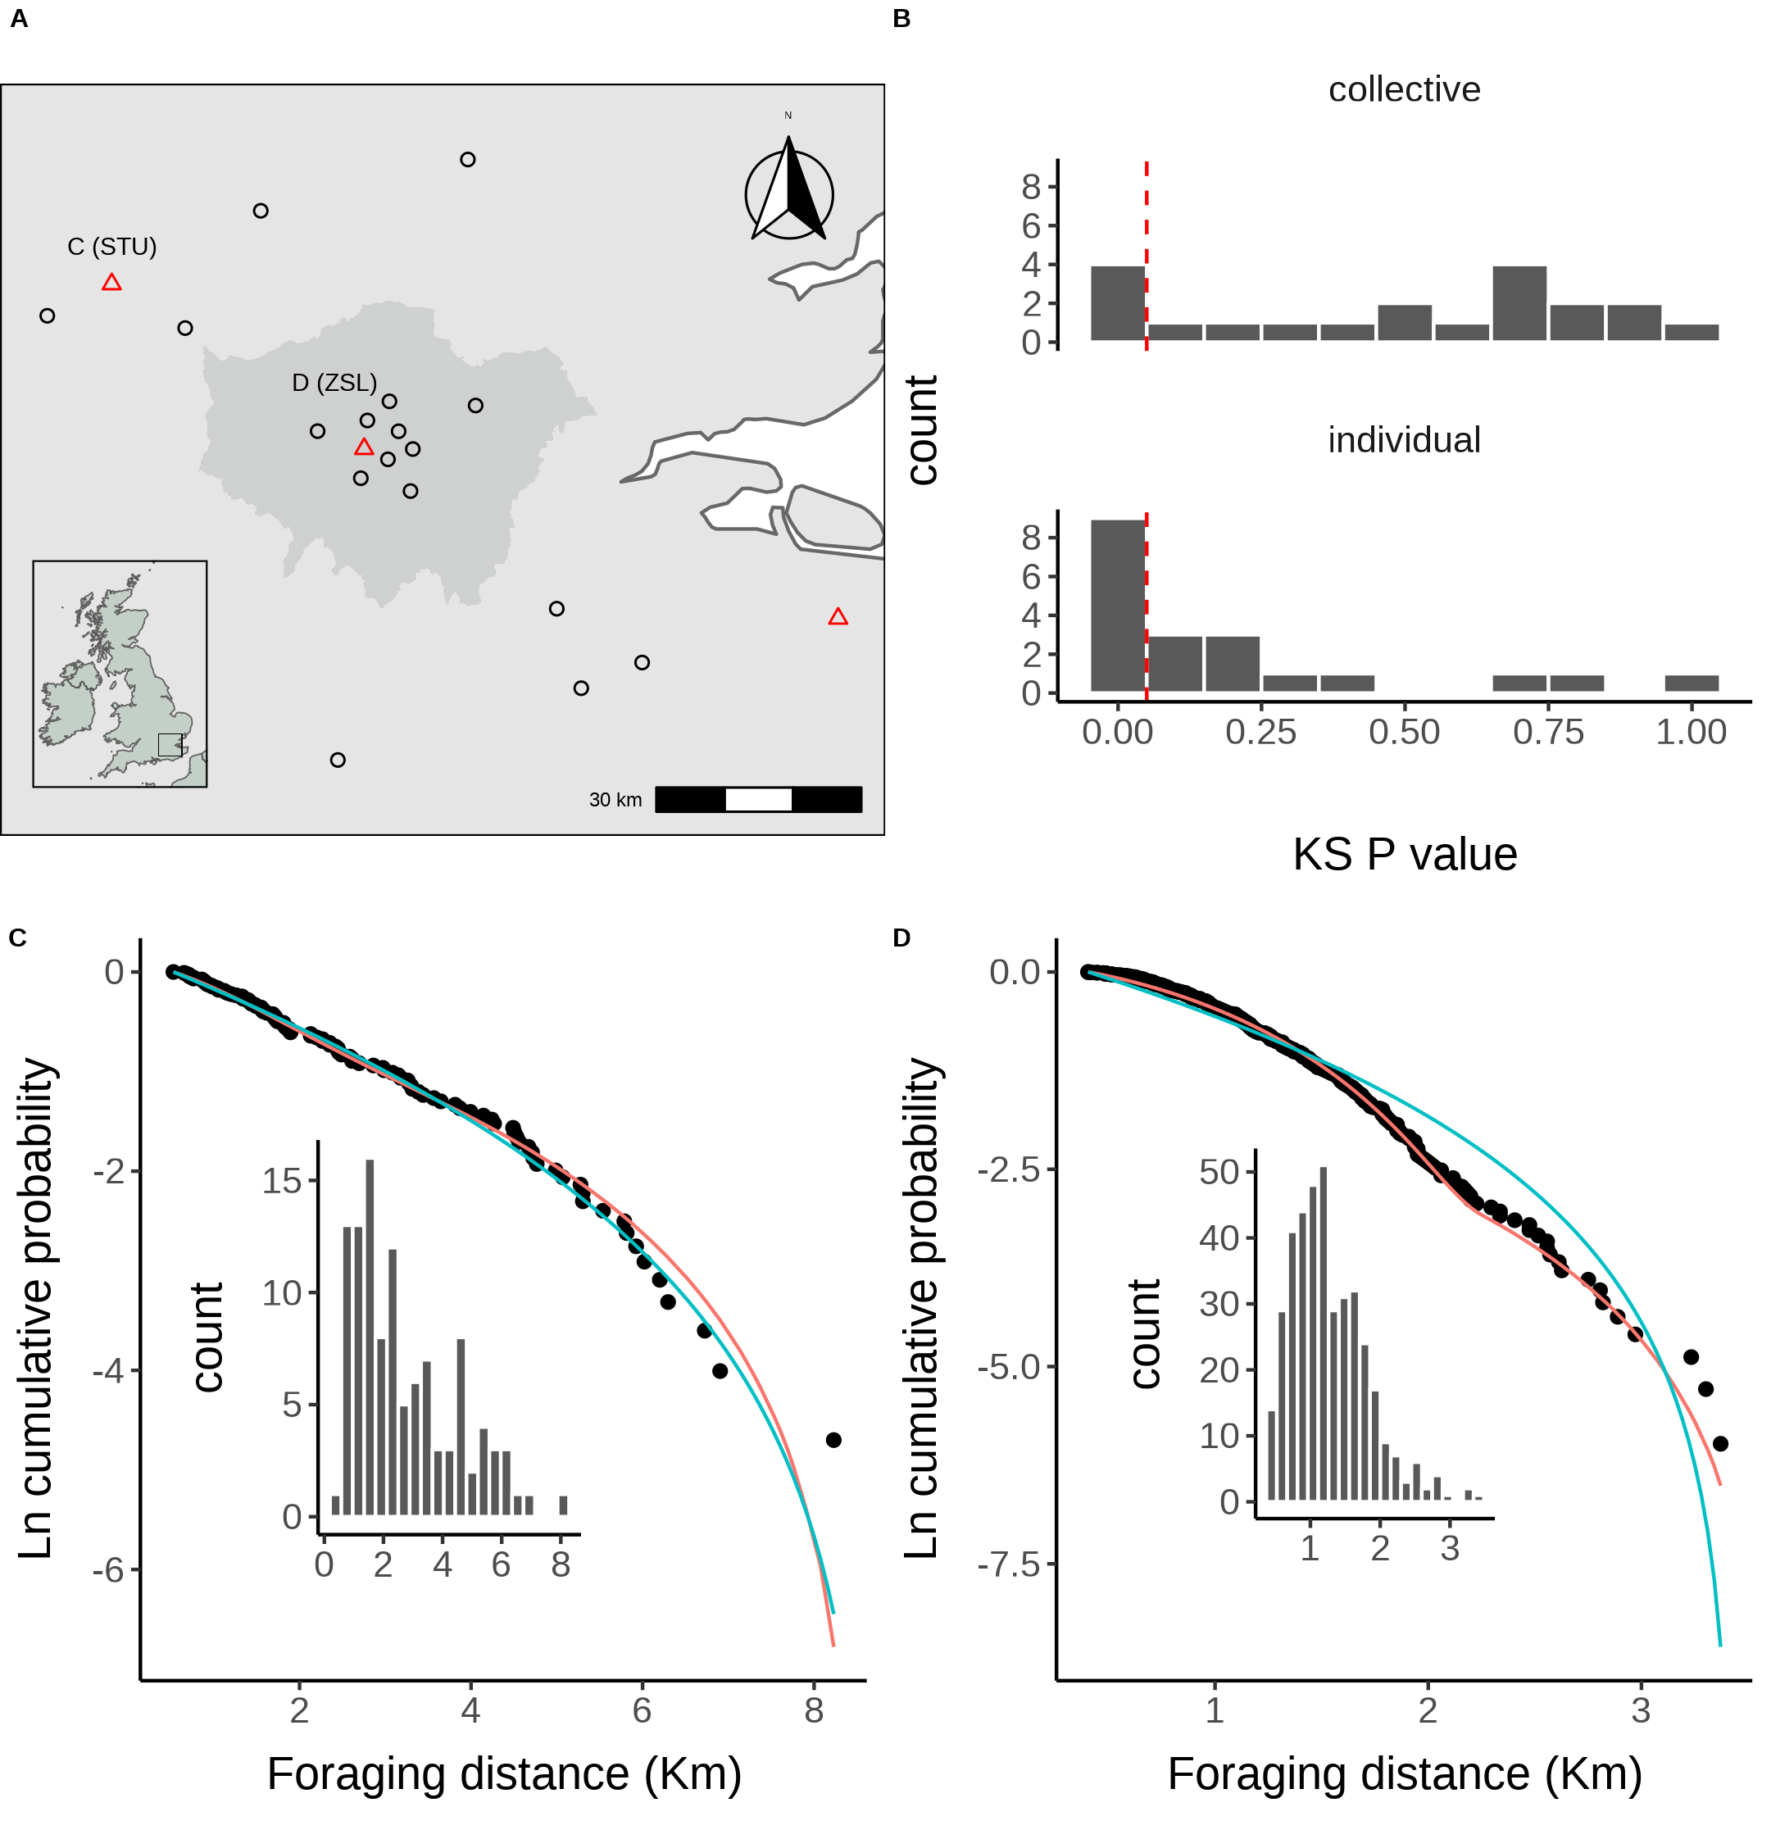
Collective model (Scouts + recruits) best 17/20
Individual model (only scouts) best in 3/20
Location of study hives in Southern England coloured by which model, collective (black circles) or individual (red triangles) provided the best explanation of the data as indicated by lowest AIC score. Sites STU and ZSL (C & D) are marked. Inset plot shows the location of the sites within the UK.

Slide 17
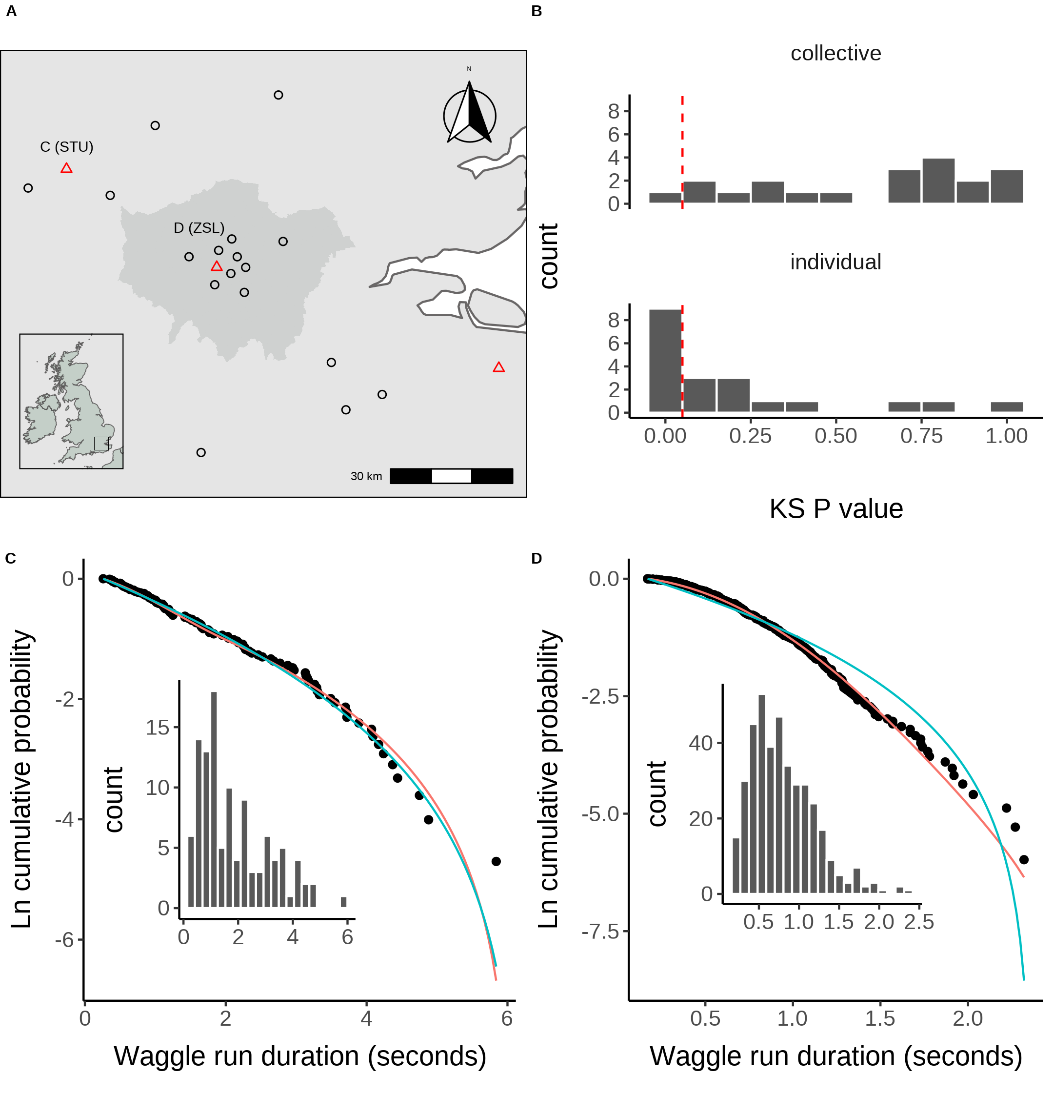
STU
ZSL
C. Model fits to waggle dance derived foraging distances collected from the STU hive along with histogram showing distribution. D. Model fits to waggle dance derived foraging distances collected from the ZSL hive along with histogram showing distribution. Model fits show the compliment cumulative frequency distribution, giving the probability of sampling a value greater than or equal to x

Slide 18
Collective model (Scouts + recruits) 19/20 sites not significantly different from data
Individual model (only scouts) 11/20
sites not significantly different from data
Both models provide a good description of honeybee waggle dance patterns
Distribution of goodness of fit confidence values for each model fit to waggle dance derived foraging distances from each site. P value is derived from a bootstrapped two-sided KS test comparing the fitted model predictions to the empirical data. The red dashed line marks the significance threshold of 0.05. Values greater than 0.05 indicate no statistically significant difference is observed between the model and the data, indicating the model provides a good fit to the data.

Slide 19
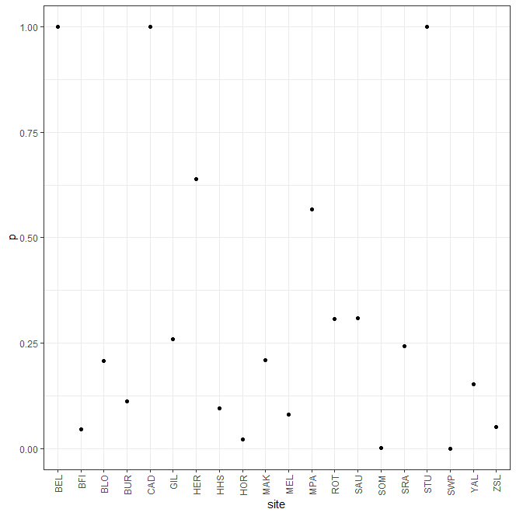
Model provides a good explanation
of the data
In most colonies foraging uses scouts and recruits
In 3 sites, foraging is readily explained by all foragers acting as scouts and ignoring the dance.
Variety of factors could influence the foraging strategy of a colony
Does land-use type have a notable influence?

Slide 20
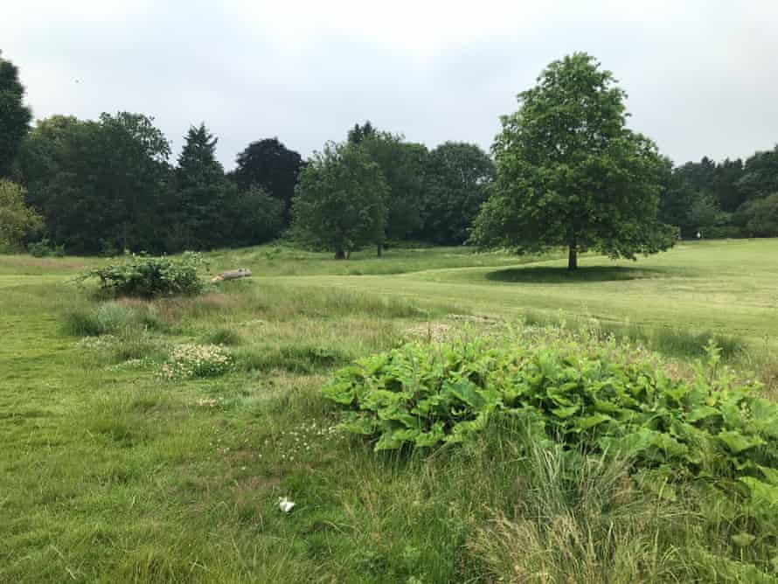
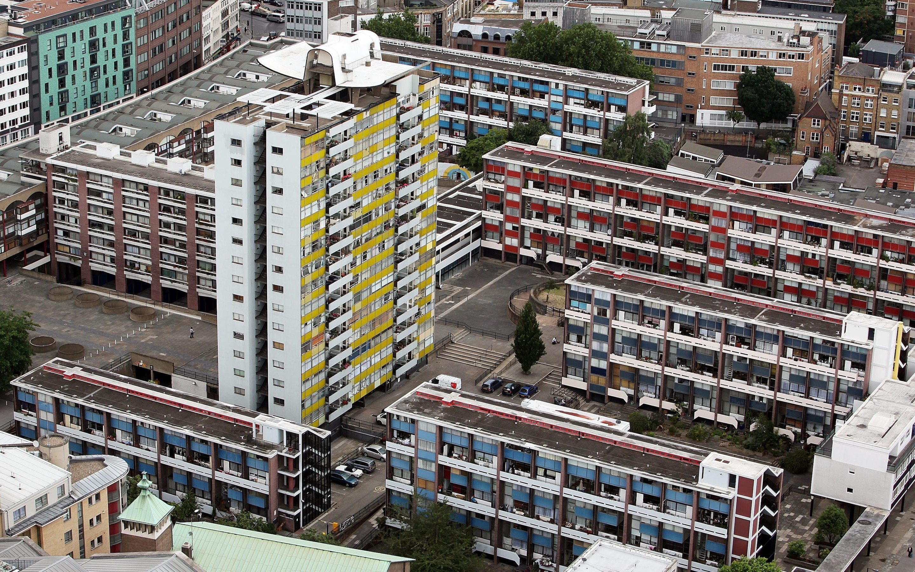
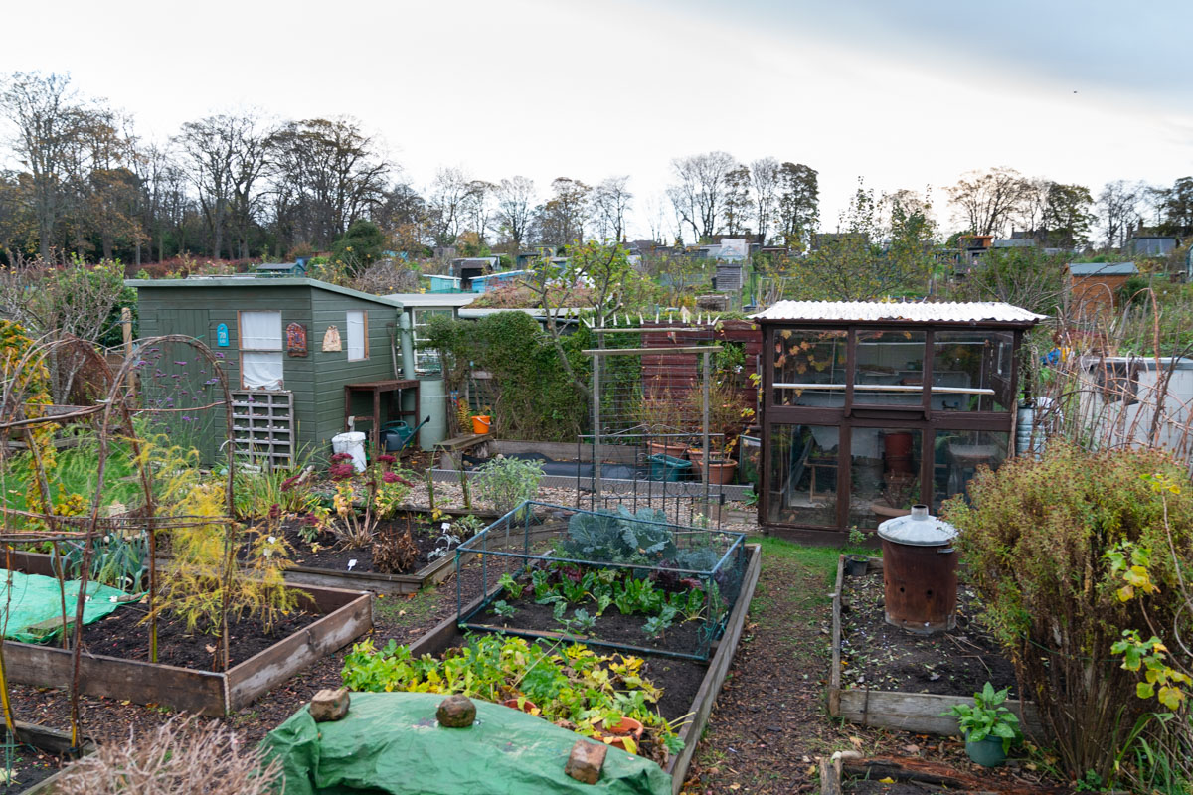
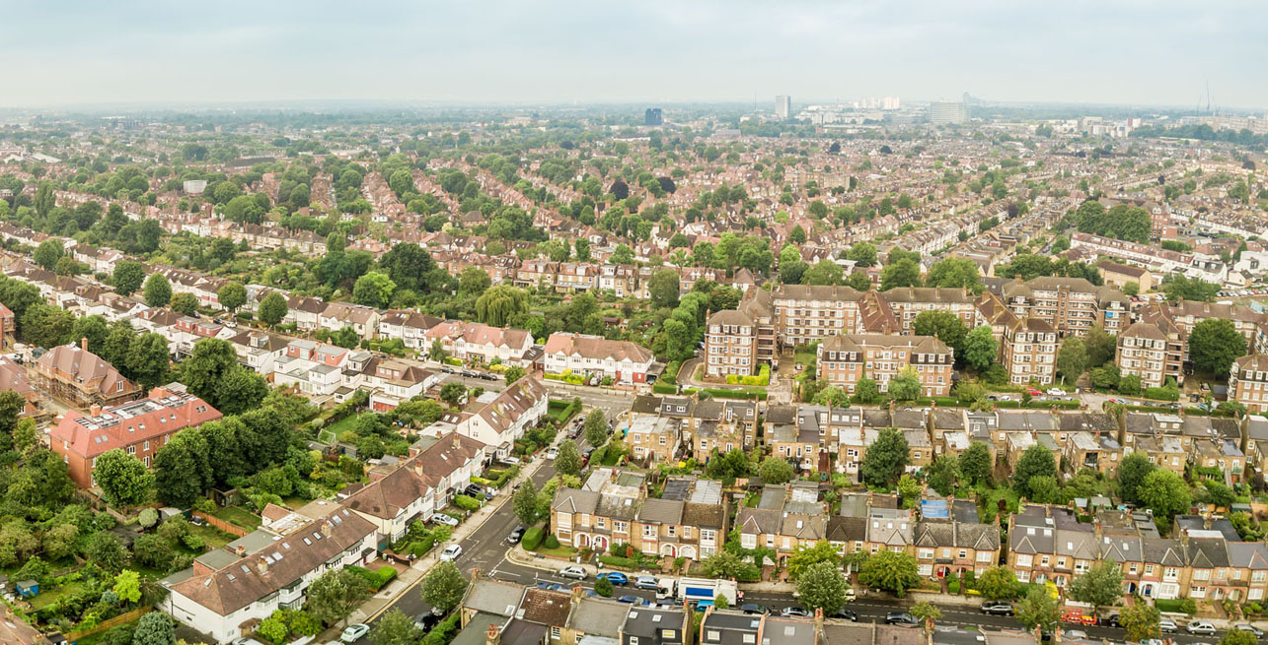
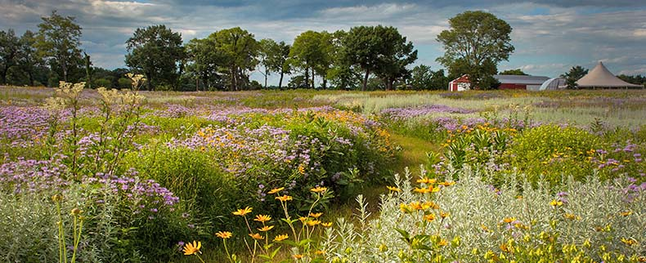
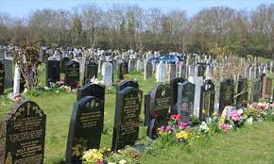
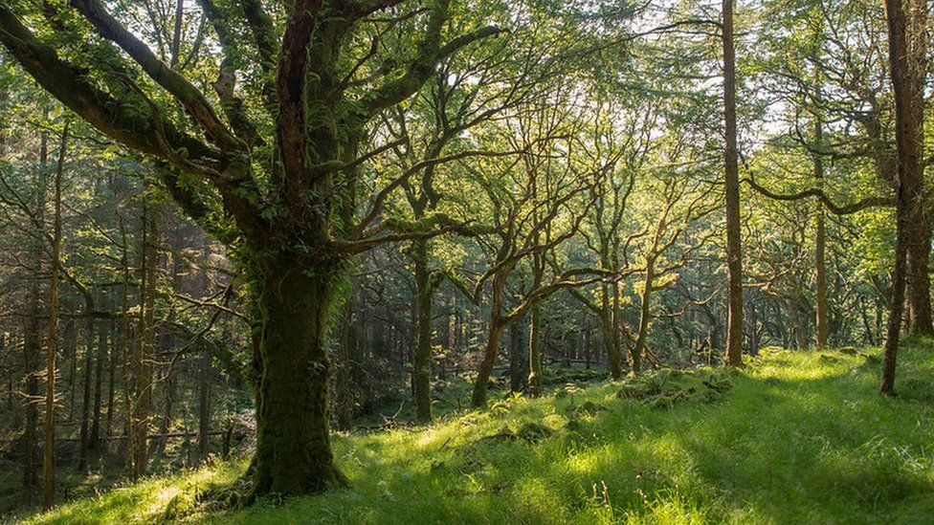
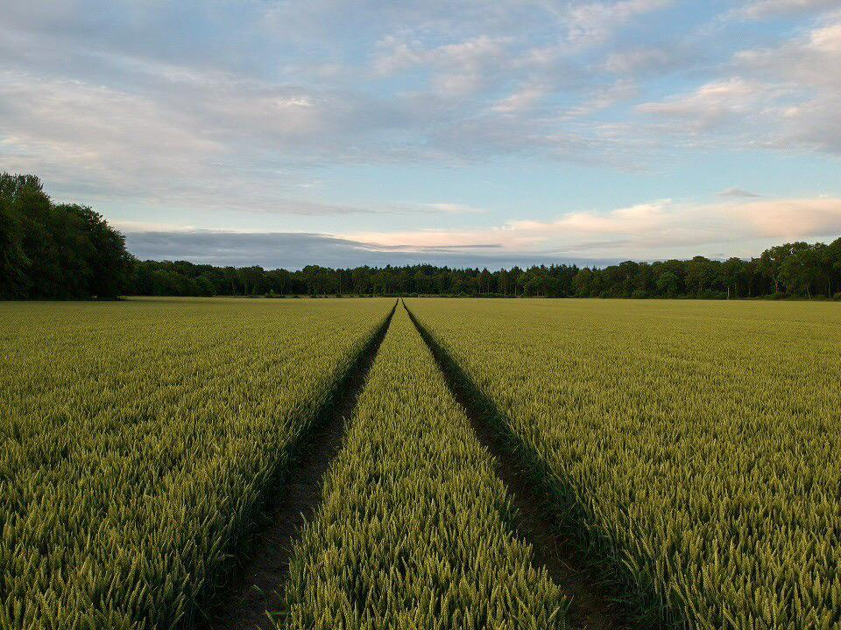
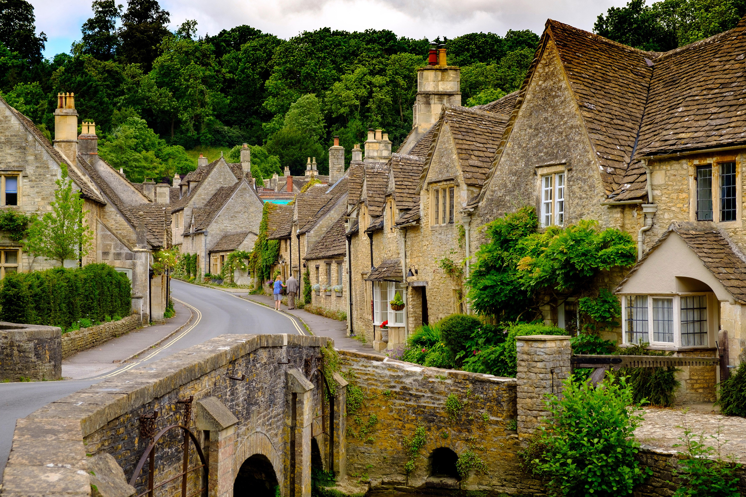

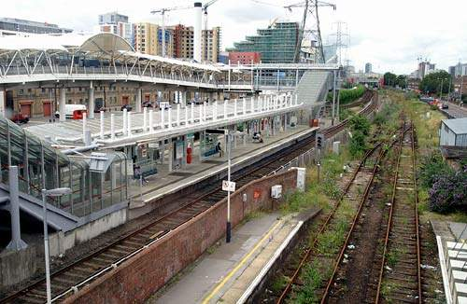
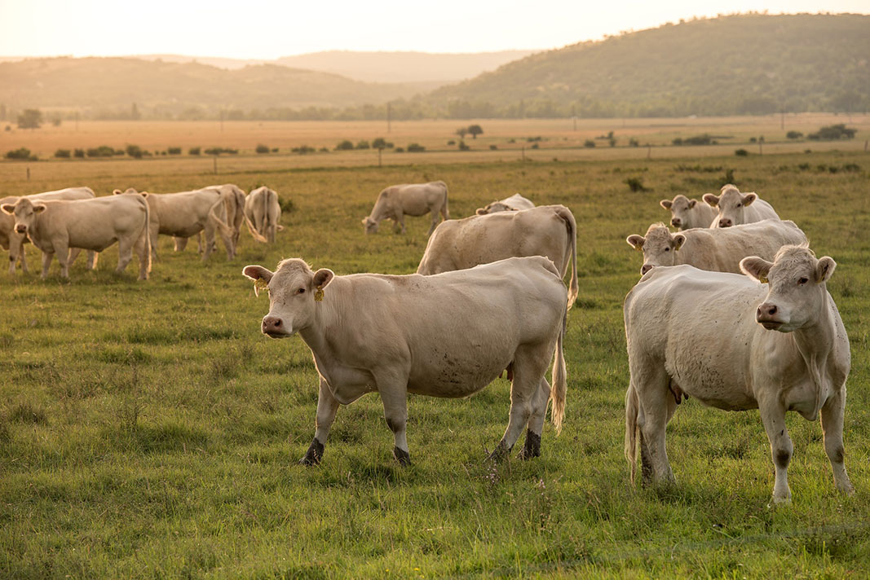
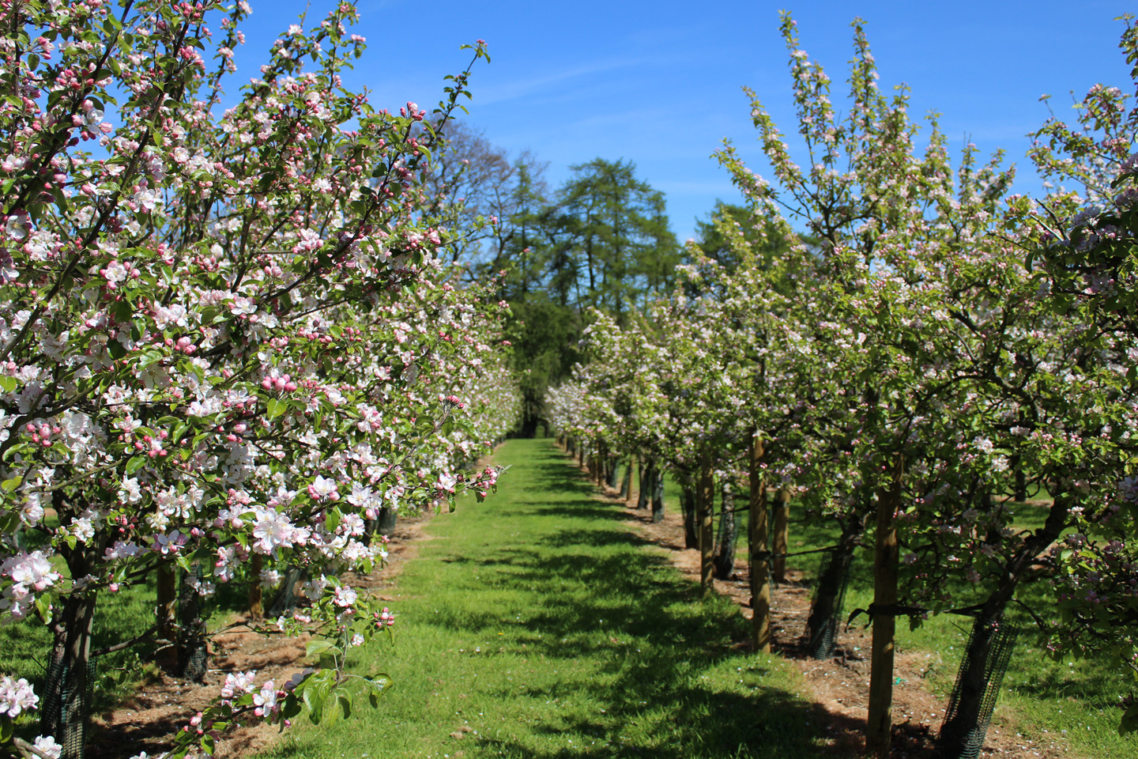
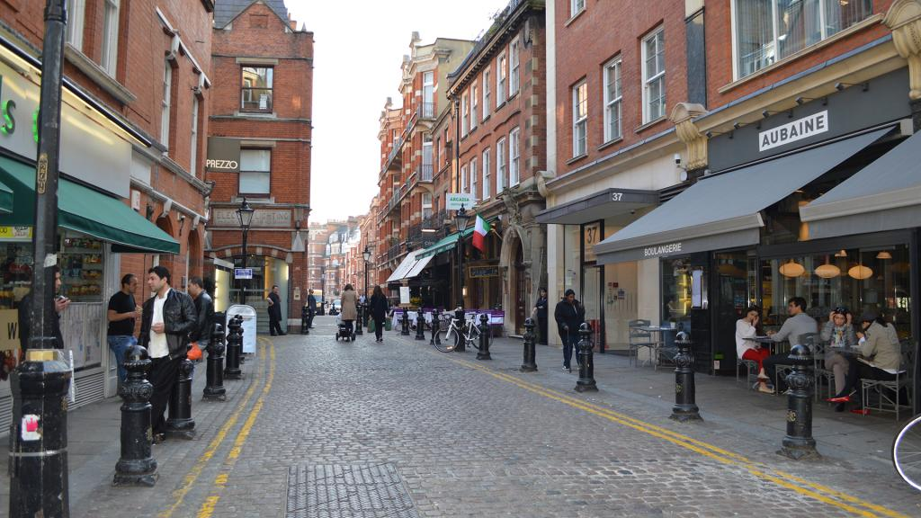
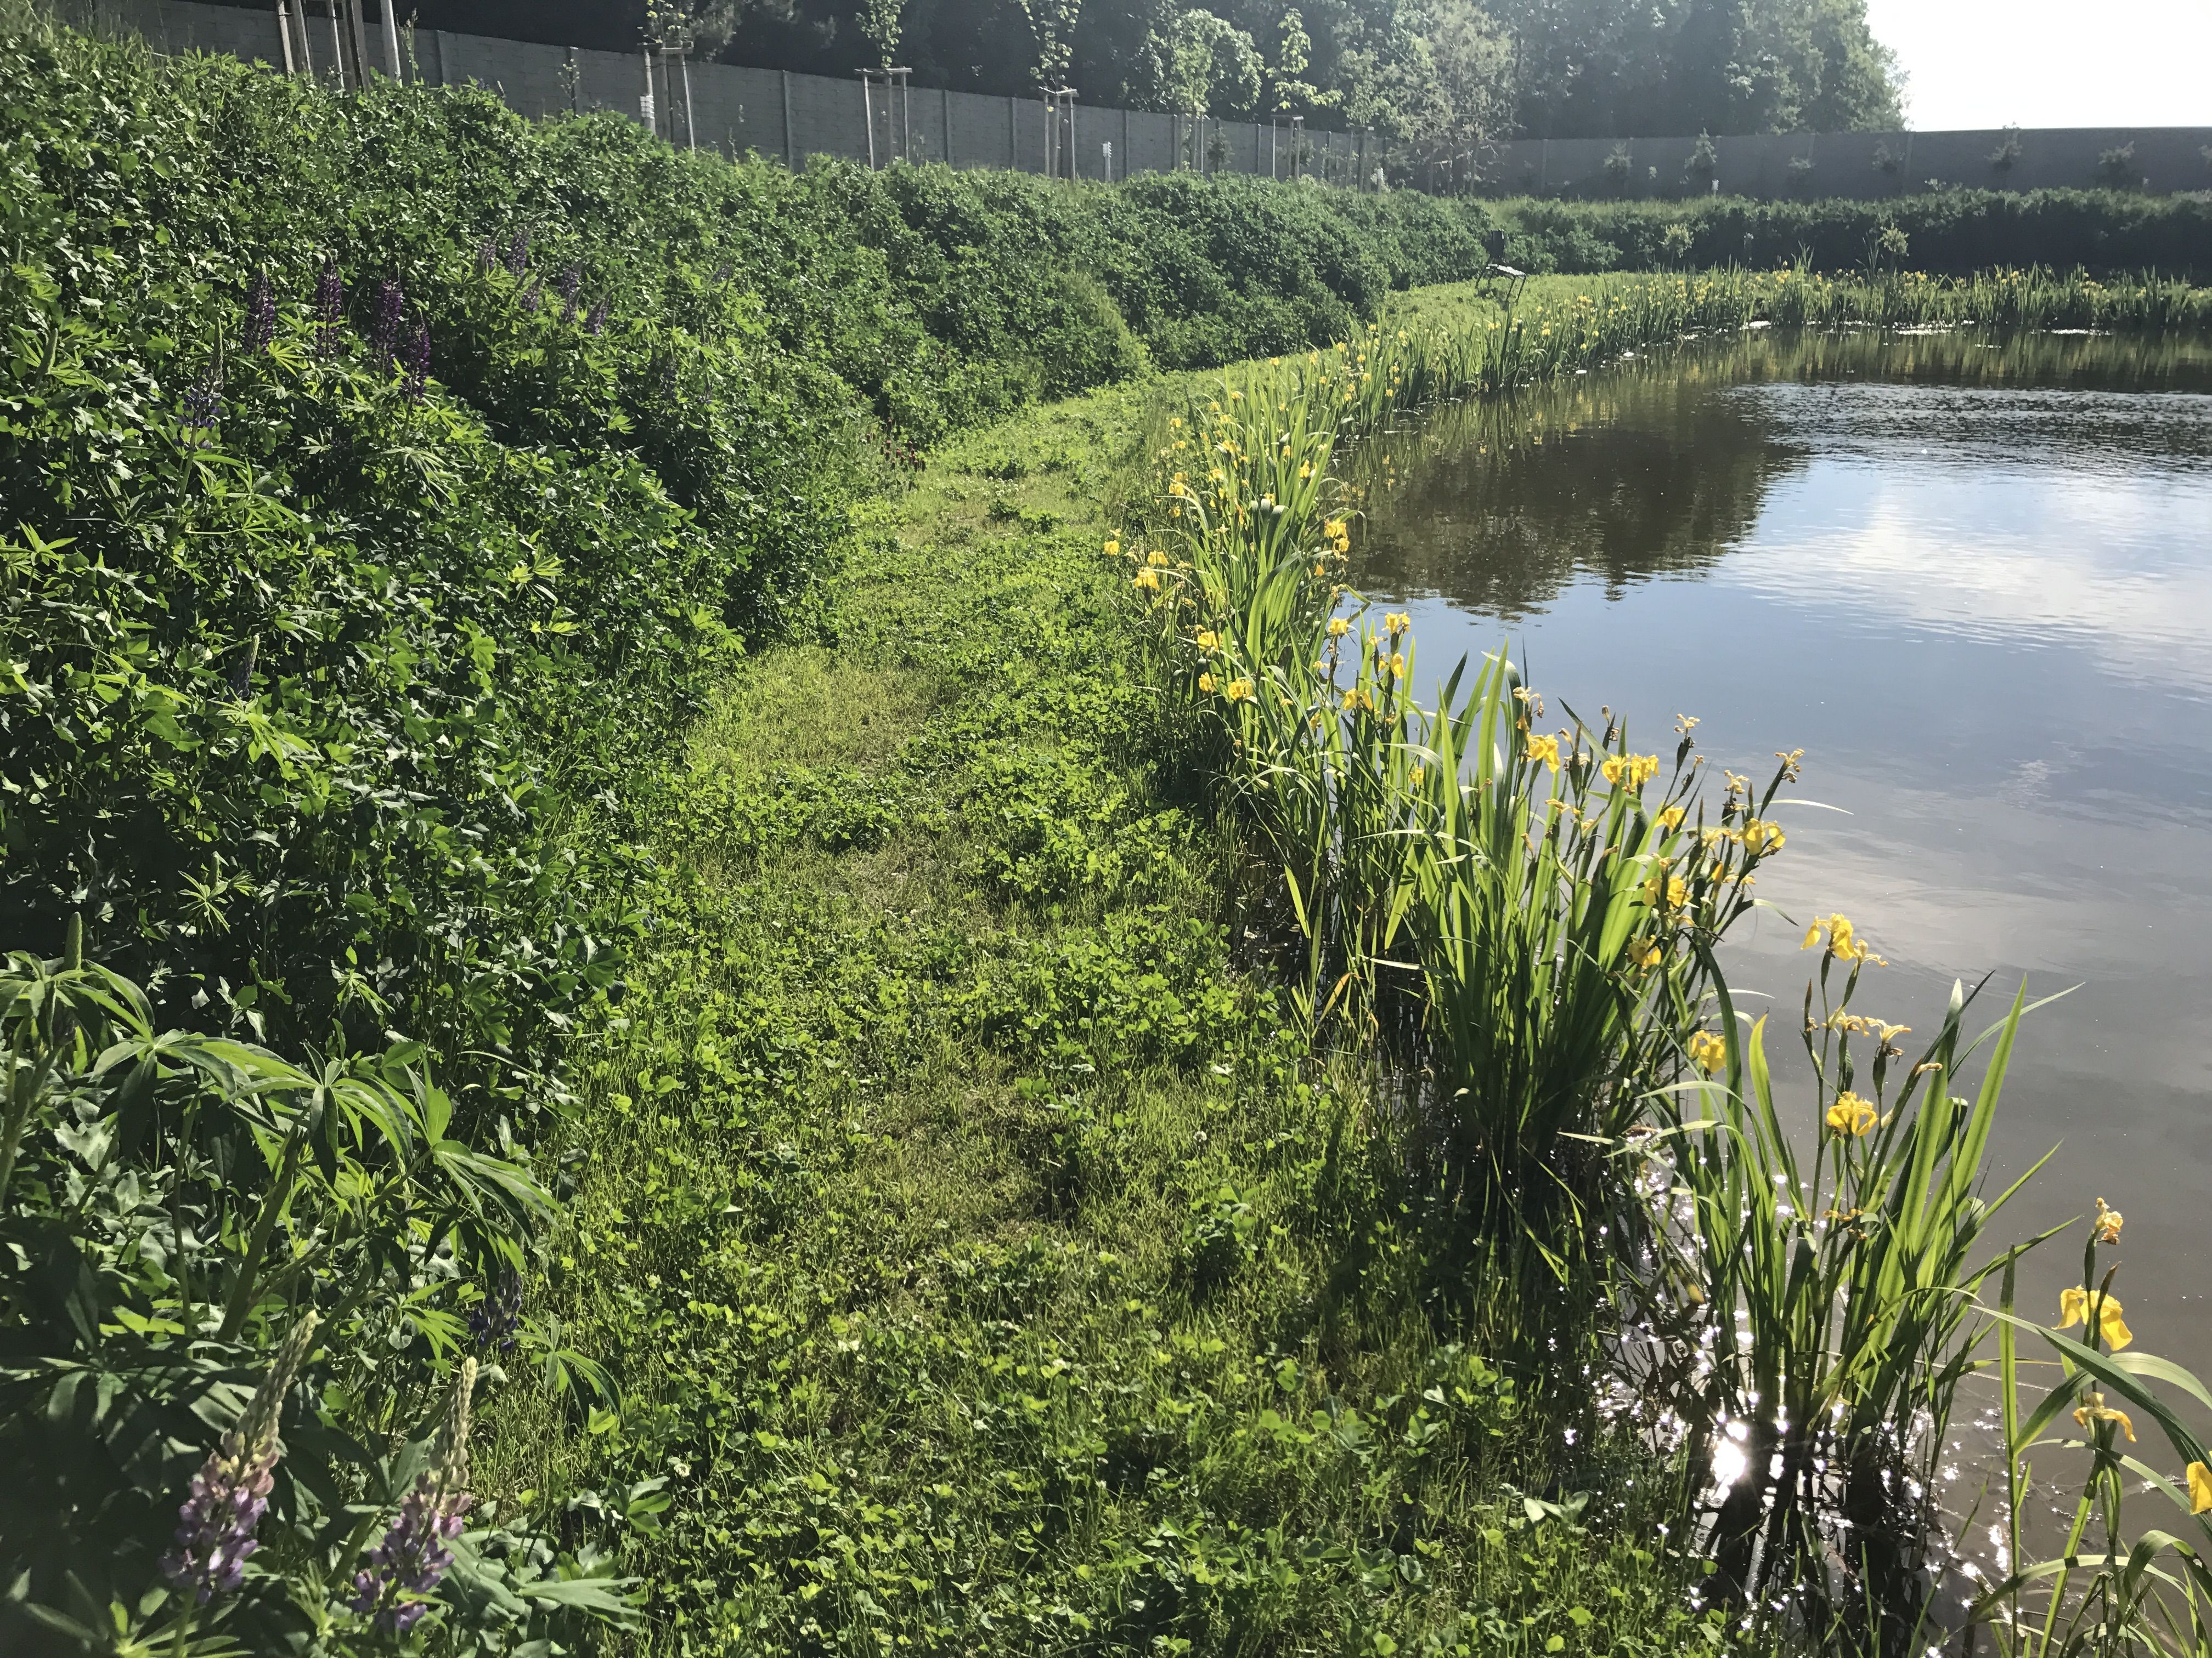
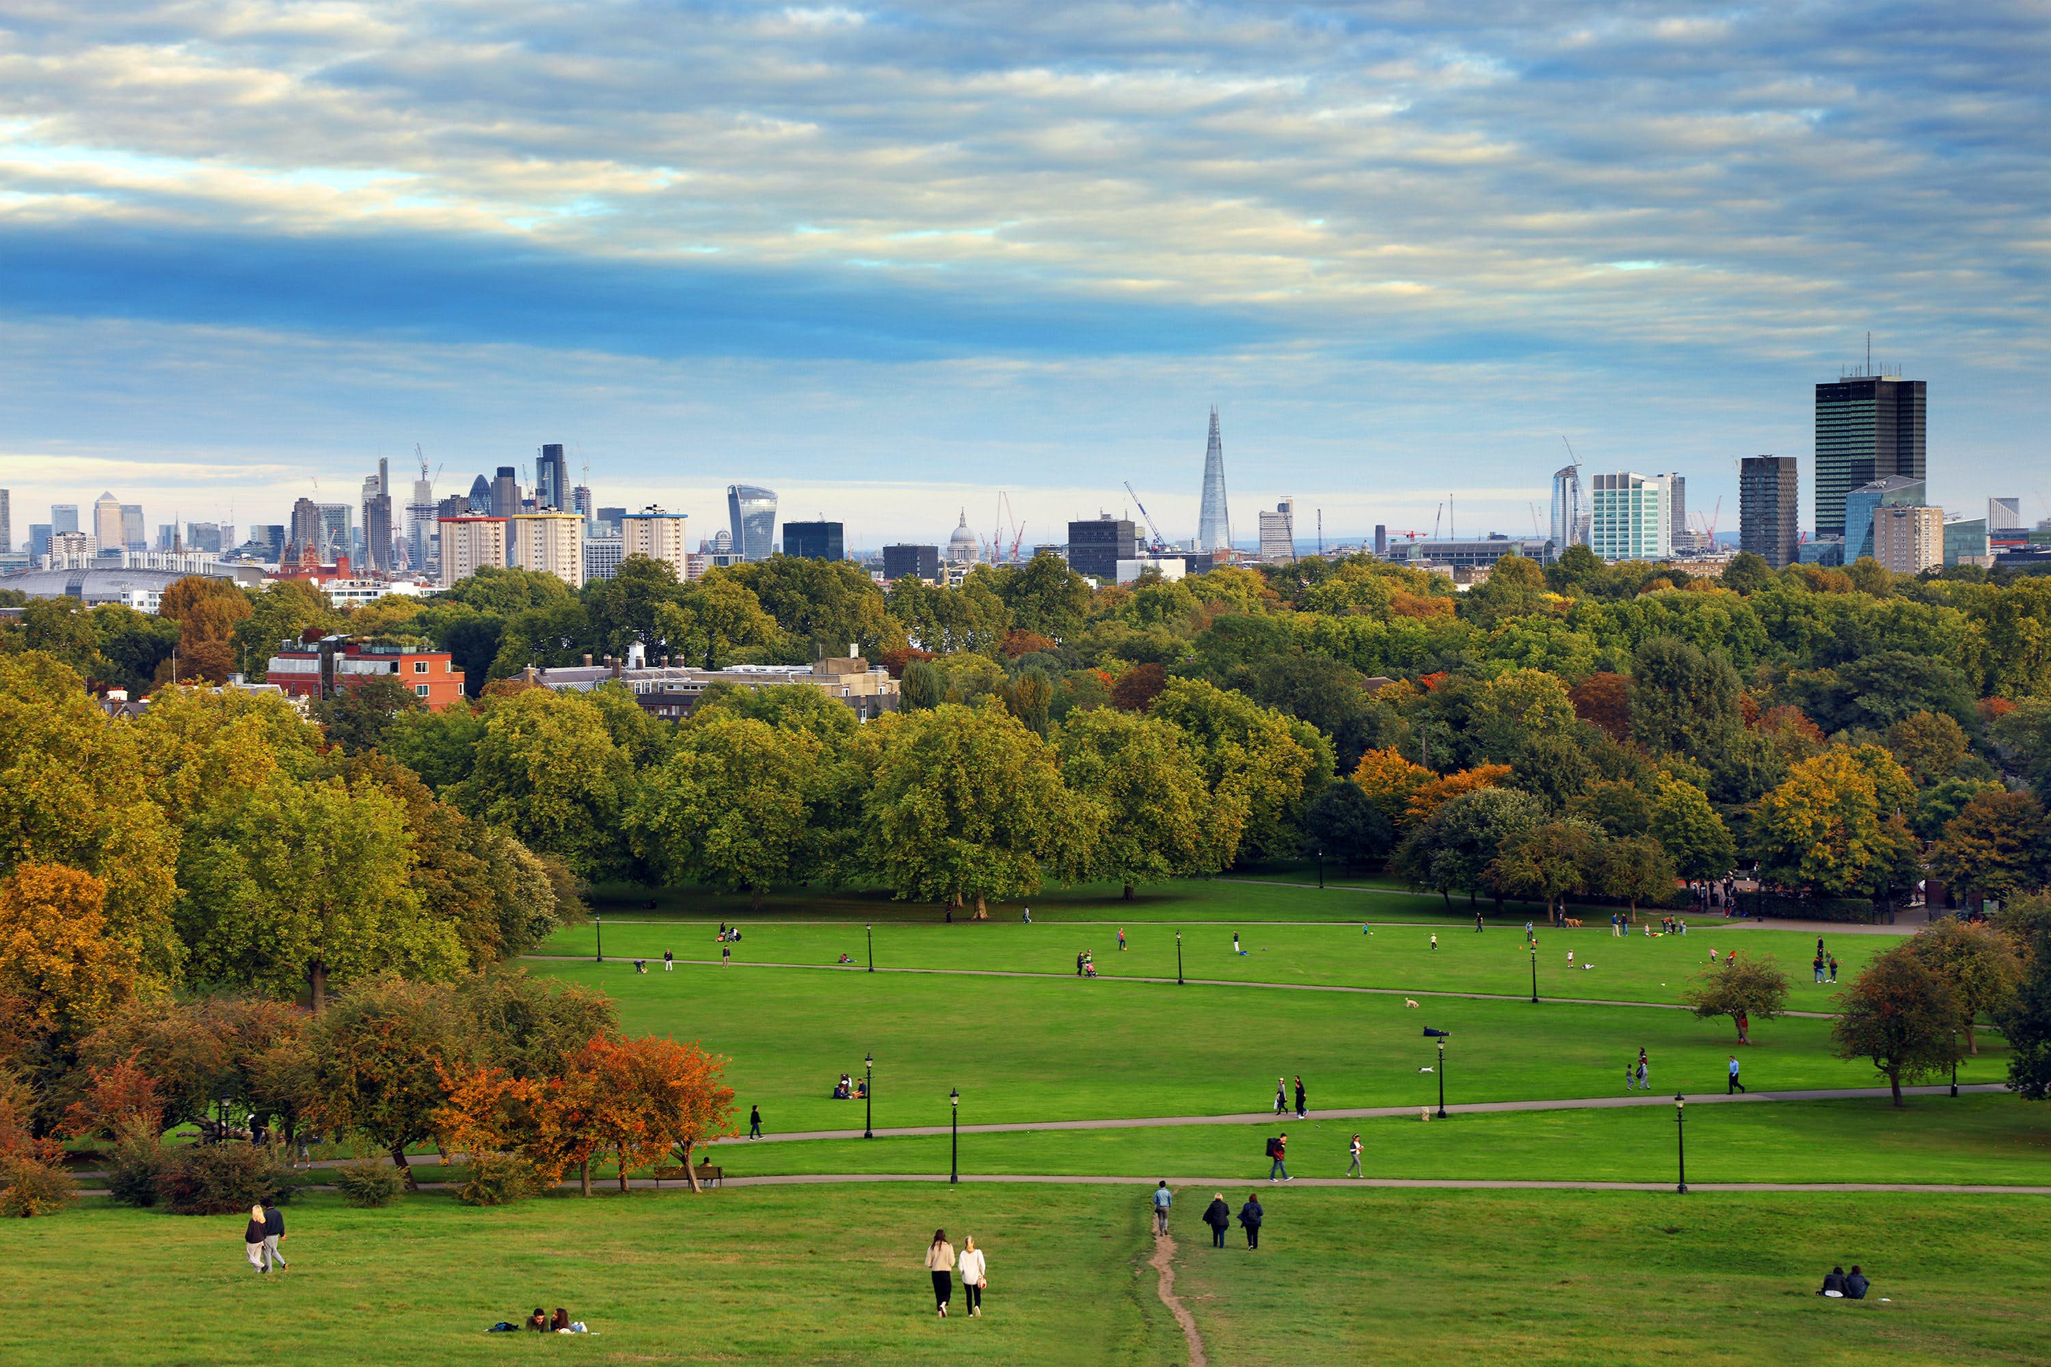
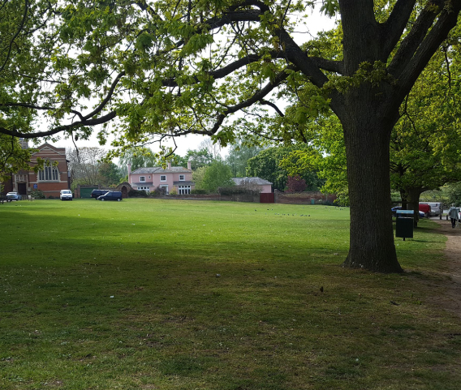
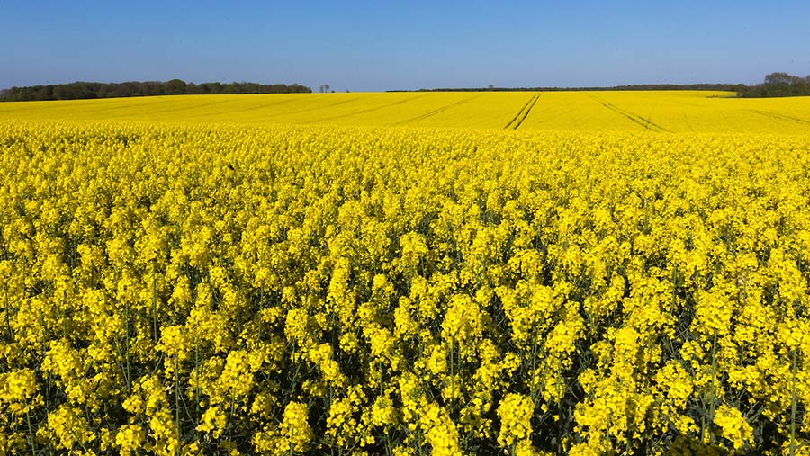
Agri-rural
Urban

Slide 21
Agri-rural
Agri-rural
Urban
Land-use | % coverage
Arable | 28.80
Pasture | 21.70
Woodland | 20.00
Built Up Area | 16.80
Fruit | 2.88
Oilseed Rape | 2.88
Non Agricultural Managed Green Space | 2.75
Non Agricultural Unmanaged Green Space | 2.65
Other Agricultural | 1.52
Water | 0.16
Land-use | % coverage
Sparse Residential | 34.80
Continuous Central | 24.30
Dense Residential | 21.80
Parks Allotments Cemeteries | 7.88
Woodland | 4.22
Water | 3.36
Amenity Grassland | 2.62
Railway | 1.04

Slide 22
Partial Least Squares (PLS) to identify what combinations of land-use type best accounts for the variation in the proportion of scouts.
Jackknifed analysis to evaluate sensitivity of results to influential sites
Arable
STU
Pasture
1
BLO
Woodland
Fruit
ZSL
BEL
CAD
HHS
HER
YAL
-1
HHS
1
ZSL
Correlation with PC1
1
-1
1
-1
CAD
-1

Slide 23
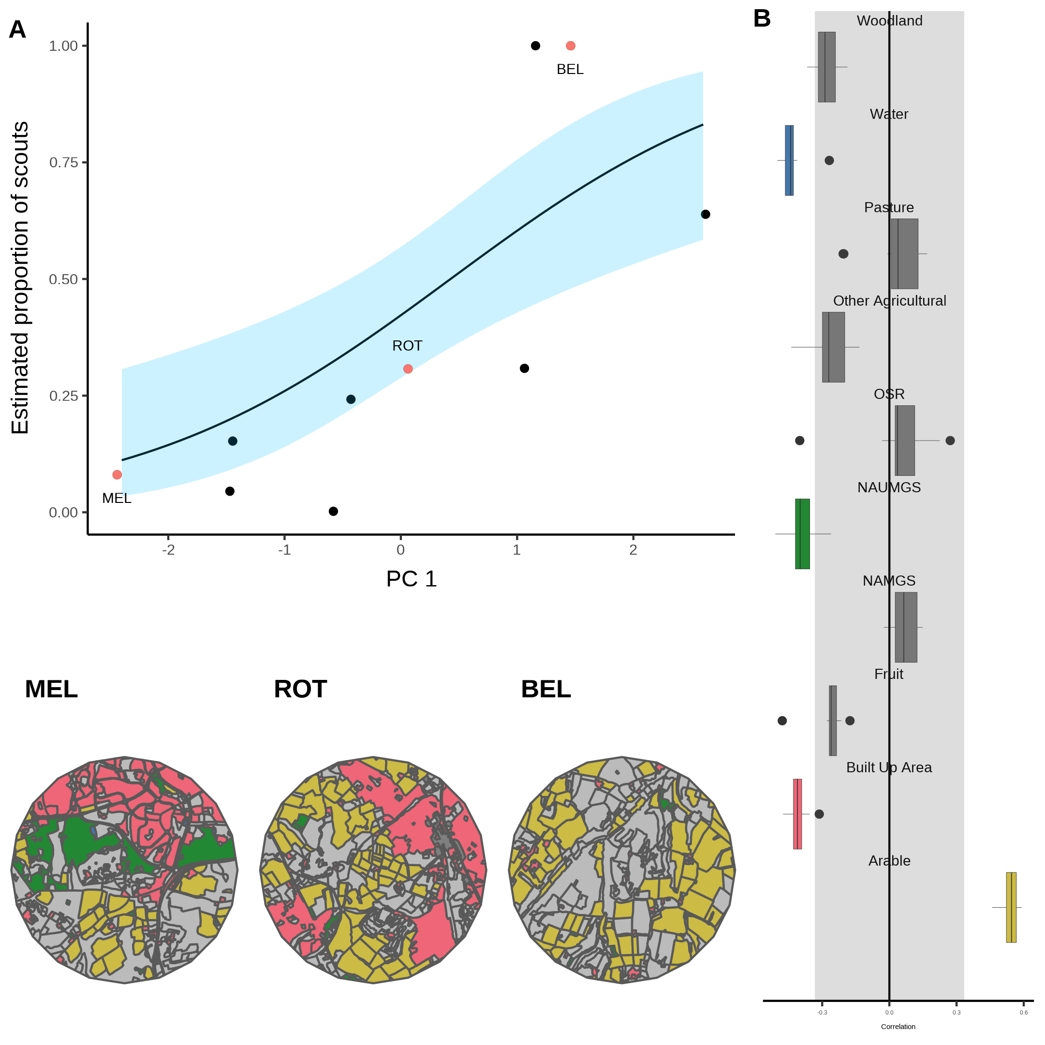
Agri-rural
A single PC explains ~52% of the variation in the proportion of scouts
Significant interaction (beta regression: R² = 0.52, ϕ = 3.7, p < 0.05)
As arable land increases whilst NAUMGS and built-up areas decrease, waggle dance use decreases.
Correlation

Slide 24
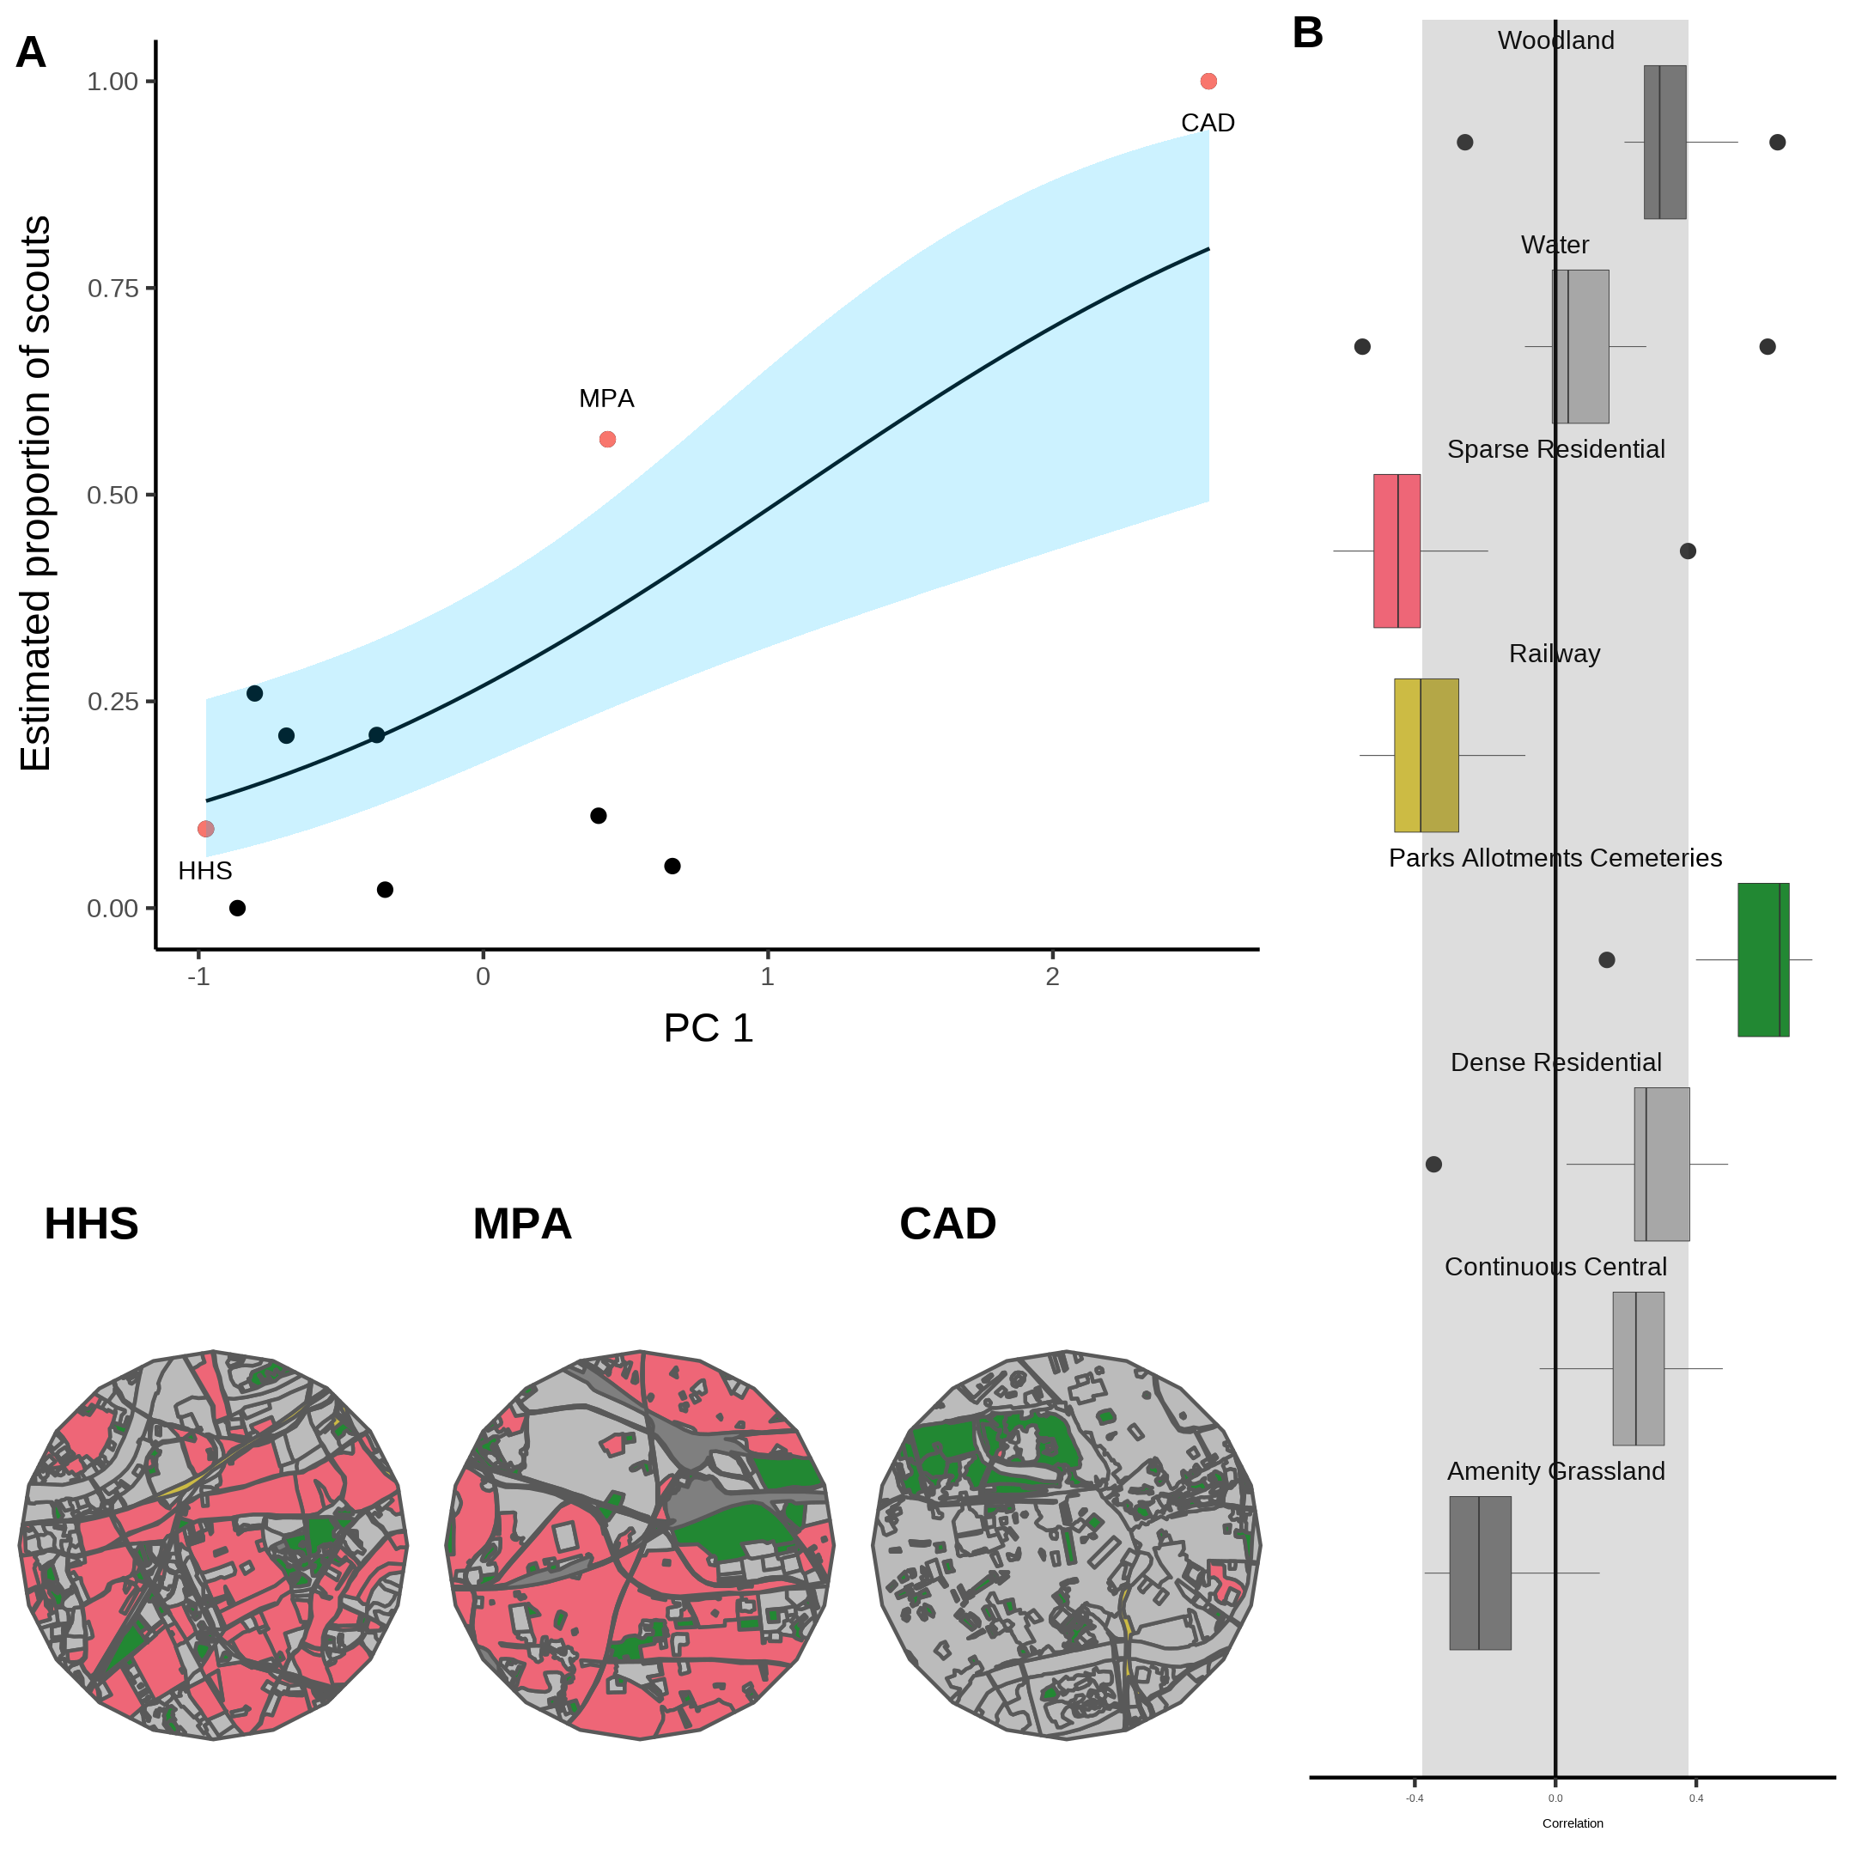
Urban
A single PC explains ~59% of the variation in the proportion of scouts
Significant interaction (beta regression: R² = 0.59, ϕ = 6.2, p < 0.05)
As residential areas become sparser and parks etc. increase, waggle dance use decreases.
Correlation

Slide 25
Does land-use type have a notable influence?
Maybe…
Agri-rural results suggests resource sparsity might be a contributing factor
No clear pattern in the urban results
More data, at a higher resolution, is required to evaluate this further
Our work opens the door to large-scale experimental exploration of waggle dance use

Slide 26
Have a new tool to quantify waggle dance use
Waggle dance use influenced by land-use type
Honey bees don’t always forage collectively
Visualise waggle dance use across different landscapes

Slide 27



Acknowledgments
Ash Samuelson, Elli Leadbeater & Vincent Jansen
Thank you for listening, questions

Slide 28
Additional slides
| | | | | |
V

Slide 29
Partial Least Squares (PLS) to identify what combinations of land-use type best accounts for the variation in the proportion of scouts.
PC 2
Variable 1
PC 1
PLS
PC 2
PC 1
Variable 2
Variable 1
PCA
Treatment: Group 1 Group 2

Slide 30
Have a new tool to quantify waggle dance use
Does the environment influence dance use?
Honey bees don’t always forage collectively

Slide 31
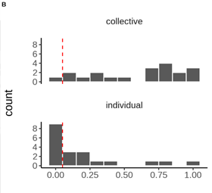
Notes:
This question of how the waggle dance is used in different environments is important as it gives us an idea both of what conditions lead to the evolution of the dance in the first place, as well as social information use in general, and how changing environmental conditions are influencing waggle dance use
To answer this question we need a better understanding of what foraging looks like under an individual or collective strategy and a methodology which allows us to compare the two. This fundamentally difficult as we can often observe one of the other but not both bahaviours at the same time. This is when we had a brain wave.
All foragers report information on the dance floor of where they’ve been.
Because of this, resources found under different foraging strategies should be identifiable from the distribution of dances reported on the dance-floor.
Now I’m not going to go into how we validated these ideas because it’s a little dry and I only have 10 minutes,but we used this idea to create a model of collective honeybee foraging made up of individual and collective foraging.
Importantly, because we did it this way we can calculate the extent to which dances stem from the use of personal or social information and obtain this value P which captures this information as the proportion of scout dances on the dance floor.

Slide 32
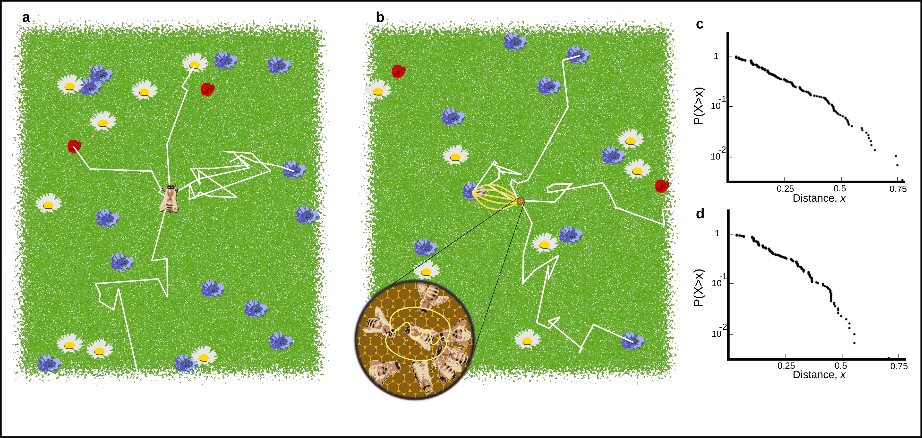
Scout (individual) foraging
Scouts leave the hive on a random flight path (white lines) and continue until they encounter a resource (flowers in the figure).
Different flowers have different qualities (e.g. nectar concentration / abundance)
Number of dances performed is biased by foraging efficiency

Slide 33
Recruits (dance follower) foraging
Recruits sample a dance randomly from the dance floor
Dances for more profitable resources are over represented
Recruits forage and dance if they judge it profitable
Process hones in on the best resources

Slide 34
Log inverse frequency distribution of foraging distances reported by scouts (C) and recruits (D).

Slide 35
Agri-rural
Urban
Notes:
Within both of our environments we classified land-use type and calculated proportional coverage within that site. For example, in the urban environment each site would have had a certain combination of things like continuous central, dense and sparse residential and parks, whilst in the agri-rural it would be combinations of arable land, unmanaged and managed green spaces and built up areas, etc. As many of these land-use types correlate with one another, we used a Partial Least Squares analysis to identify the main axis of land use-type which best explains the variation in the proportion of scouts estimated for each site.

Slide 36

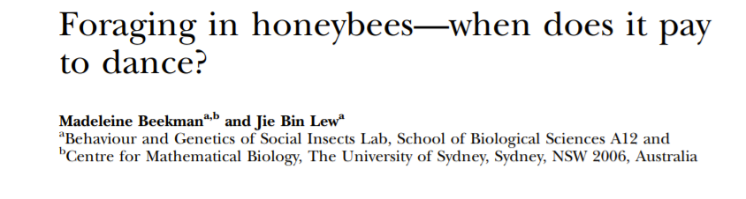
Prioritise personal information
(Act like a scout)
Prioritise Social information
(Act like a recruit)

Slide 37



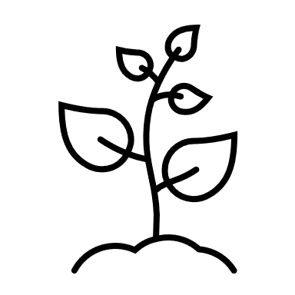

X10
X3
Scout
Recruit
Notes:
Very broadly, when honeybees forage they can either act as a scout or a recruit.
Imagine some hive situated in an environment with flower patches of different qualities.
A scout will head off on a random trajectory and search without information until they find a flower patch.
They then return to the hive and perform waggle dances for that resource to provide the location to nest mates. Crucially, when they dance the convey how good they think the resource is by the number of waggle runs performed, with more profitable resources eliciting more dances. In the hive recruits wander the dance floor randomly and so are more likely to encounter a dance for a profitable resource.
They then also go out and forage at these sites.
And will also perform dances for that resource on their return, creating a collective process which pools individual information to identify the best resources.

